Slide 1
Experiment – 1
PRN : 25070521165
1.1.1 Area of Circle
Algorithm
STEP 1 : Start
STEP 2 : Input radius
STEP 3 : Calculate
area = 3.14*radius*radius
STEP 4 : Print area
STEP 5 : Stop
Flowchart
Start
Input radius
area = 3.14*radius*radius
Print area
Stop

Slide 2
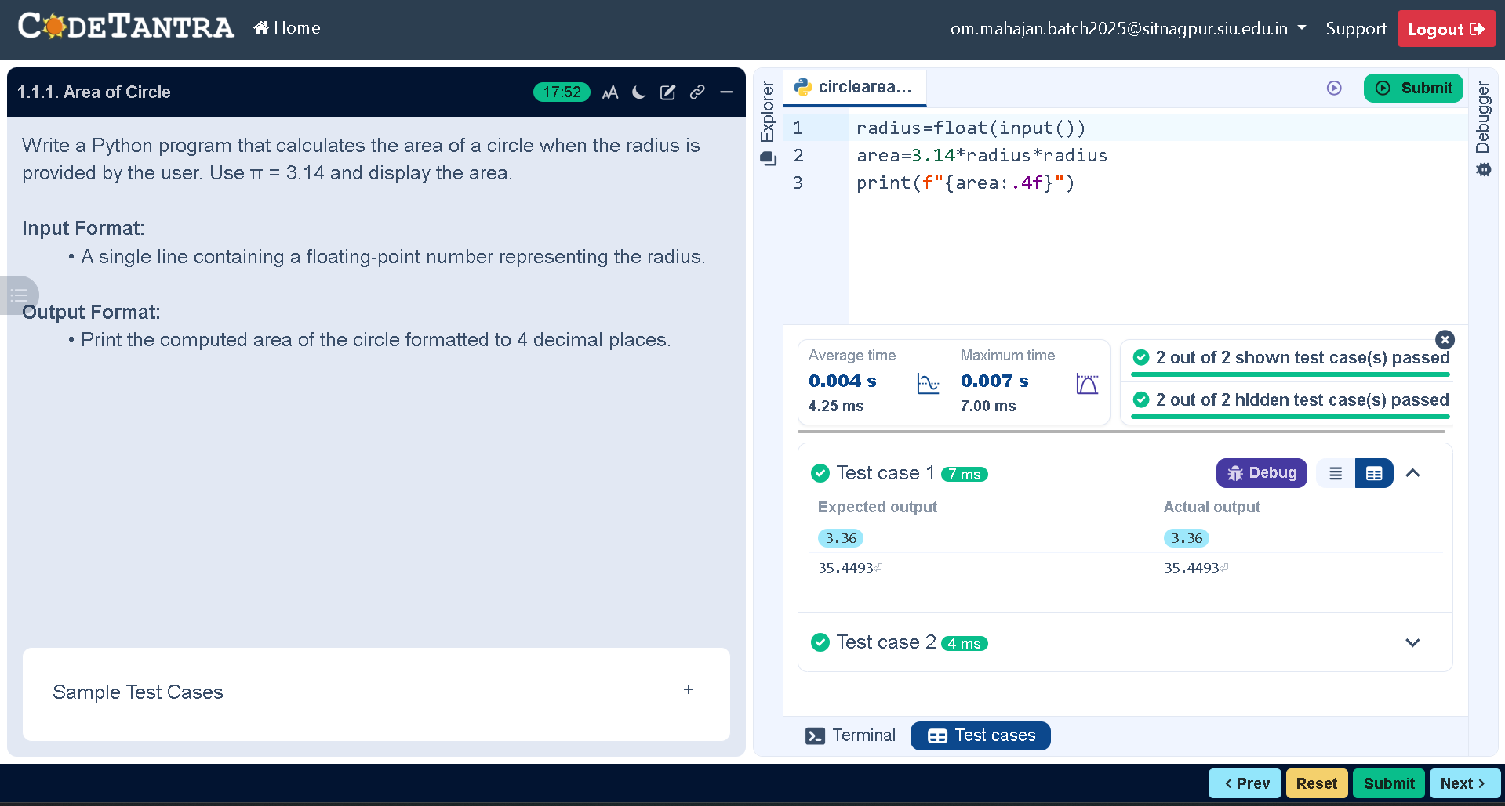
PRN : 25070521165
Code
radius=float(input())
area=3.14*radius*radius
print(f"{area:.4f}")
Execution

